Slide 1
Examining Alzheimer’s Disease biomarkers with linear modeling
Annie Bryant
OLET 5608 Final Presentation
18 May 2022
Notes:
Hi! My name is Annie and I’ll be presenting my exploration of Alzheimer’s Disease biomarkers with linear modeling.

Slide 2
Presentation Outline
Brief background on Alzheimer’s Disease (AD) biomarkers
Overview of open AD dataset used
Linear modeling approach – evaluation of assumptions and performance
Results and comparing models
Conclusions, limitations, and future implications for AD research
Notes:
As an overview, I’ll be walking us through a quick primer on Alzheimer’s Disease or AD biomarkers, the open-access biomarker dataset I used, my approach to linear modeling and assumption testing, key results, and future research questions.

Slide 3
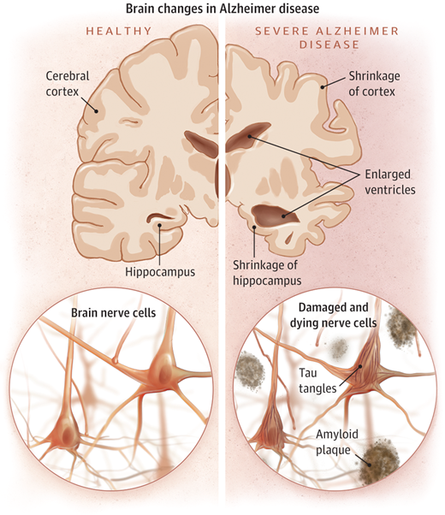
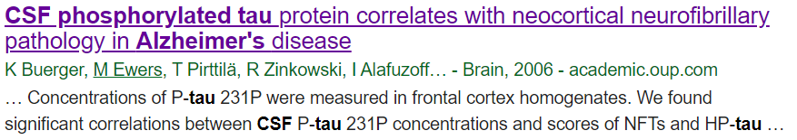
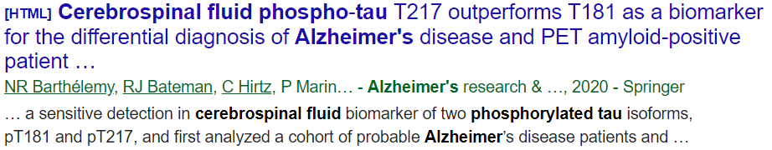
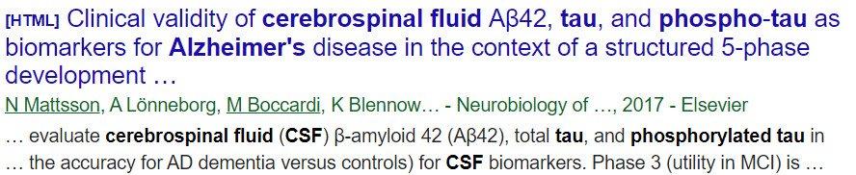
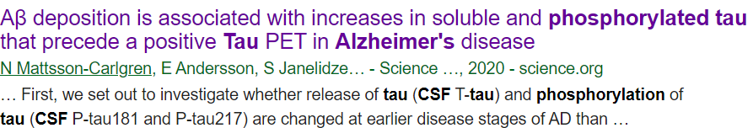
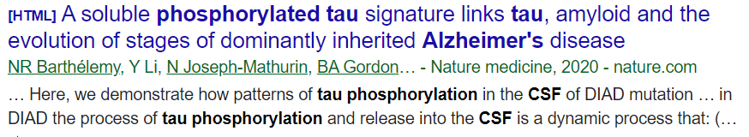
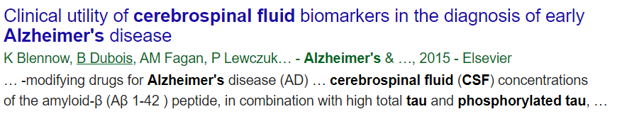
Understanding Alzheimer’s Disease (AD) Biomarkers
Question: can we understand the cognitive and neurobiological factor(s) driving AD-related changes in cerebrospinal fluid (CSF) hyperphosphorylated tau (PTAU) levels?
Image source: Jin (2015)¹
Notes:
I chose to focus on AD biomarkers since it’s been my area of study since early undergrad.
[click] this figure shows some of the key biological changes that occur in AD, namely neurodegeneration as evidenced by thinning cortex and growing ventricles (which store fluid in the brain). At a more micro-scale level, we see accumulation of two types of proteins inside of neurons: amyloid-beta plaques and tau neurofibrillary tangles. The latter was my area of focus at my previous job before starting my PhD, so I was really keen to explore biomarkers related to tau pathology in AD.
[click] While it’s of course impossible to actually look inside the neurons of an AD patient while they’re alive, we can get a fairly good sense of how much tau pathology is in the brain by examining cerebrospinal fluid, which is a fluid that flows between the brain and spinal cord and can be accessed via spinal tap. Within the last ten years, many landmark studies have come out showing that the amount of phosphorylated tau (aka the type of tau protein that forms tangles in the brain) in CSF is highly predictive of AD many years before symptoms present.
[click] So I started wondering if there were any biological and/or cognitive biomarkers that are in turn influencing the amount of phospho-tau in the CSF.

Slide 4

Leveraging open-access AD biomarker data
Alzheimer’s Disease Neuroimaging Initiative (ADNI)
Data is open to the research community
Predictor variables are diverse
Cognitive: ADAS11, ADAS13, CDRSB, MMSE
Demographic : Age, Gender, Education, Marital Status, Race
Genetic: APOE4
Structural MRI: Entorhinal, Fusiform, Hippocampus, ICV, MidTemp, Ventricles, WholeBrain
PET: FDG
CSF: ABETA
N = 19 predictor variables
N = 1 outcome (CSF PTAU)
ADNI is a longitudinal multi-center study that collects clinical, neuroimaging, genetic, and biochemical biomarkers to enable early detection and monitoring of Alzheimer’s Disease (AD)².
I chose to use the “ADNIMERGE” table, which can be downloaded directly from the ADNI repository or accessed via the ADNIMERGE R package³.
N = 701 subjects
Notes:
I opted to explore this question using the Alzheimer’s Disease Neuroimaging Initiative database, which is a huge multi-center repository for AD biomarker tracking.
[click] All of the ADNI data is openly accessible, and I downloaded a cross-sectional dataset designed specifically for hackathon challenges that has a total of 701 unique subjects after data cleaning.
[click] This dataset contains a total of 19 predictor variables spanning cognitive, demographic, genetic, neuroimaging, and CSF-based biomarkers.

Slide 5
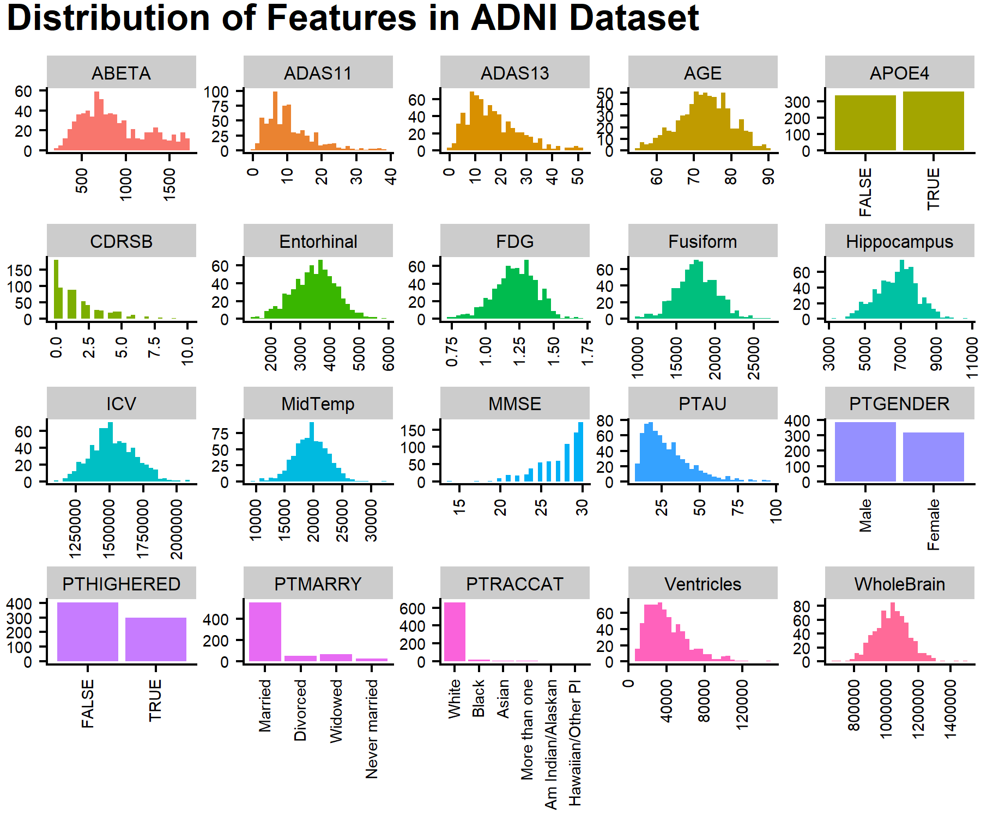
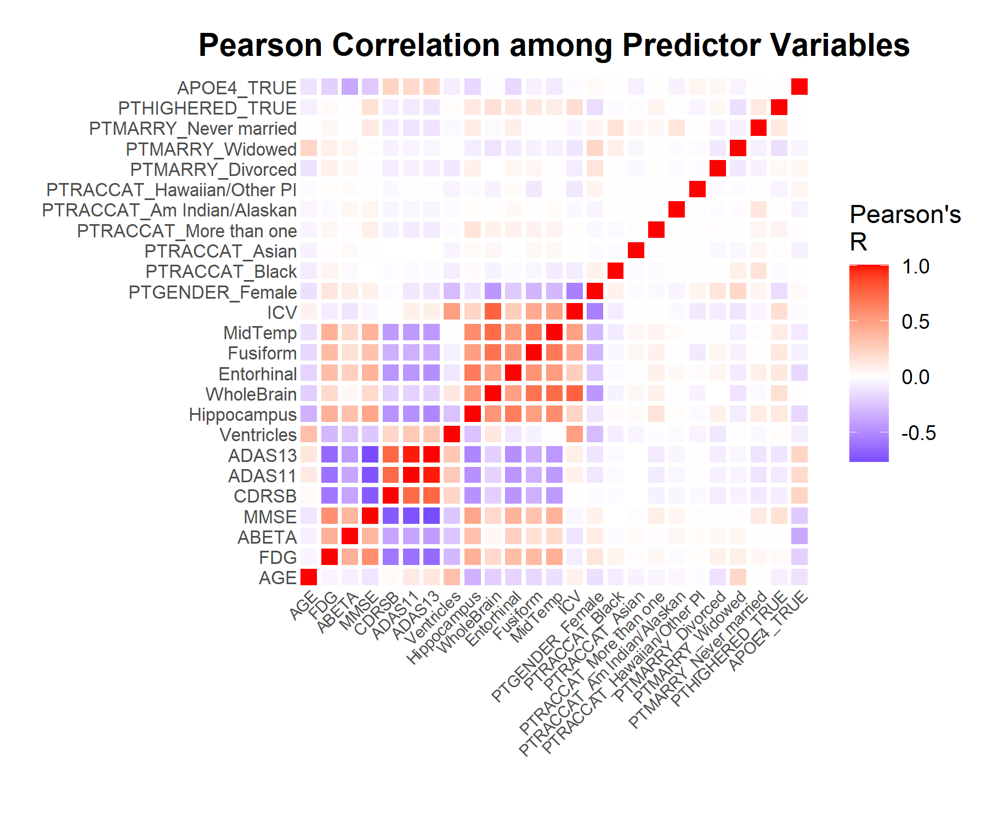
Exploring predictor and outcome variables
Notes:
My first step after data cleaning was to perform exploratory data analysis, by first visualizing the distribution of all of the predictor and outcome variables together. I’ve outlined the outcome variable (PTAU) in red.
[click] I also visualized the Pearson correlation between each pair of predictor variables to get a sense of potential multicollinearity. Of note, some of the issues could arise from the cognitive tests like ADAS11 and ADAS13 which are two different versions of the Alzheimer’s Disease Assessment Scale, as well as some of the brain region volume measurements since neurodegeneration tends to affect the whole brain. That’s just something to be aware of.

Slide 6
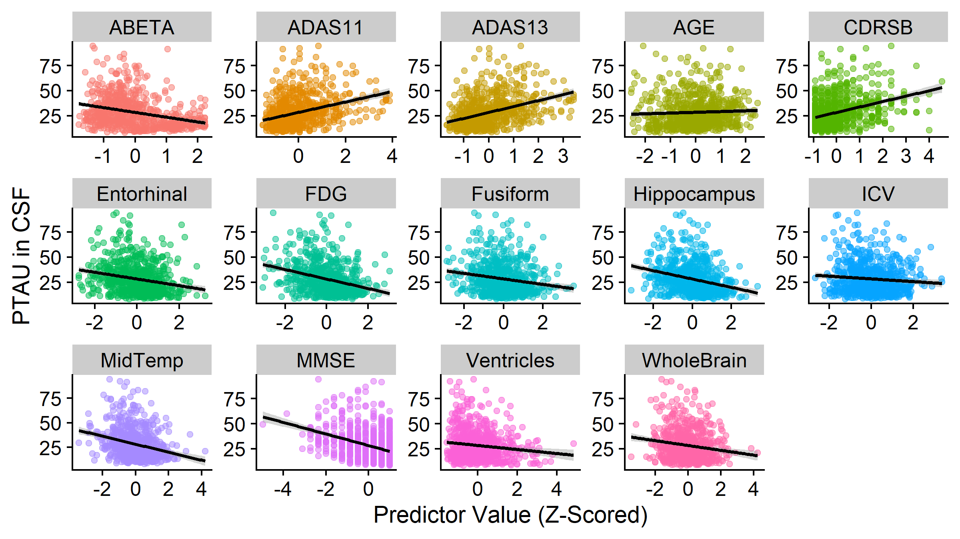
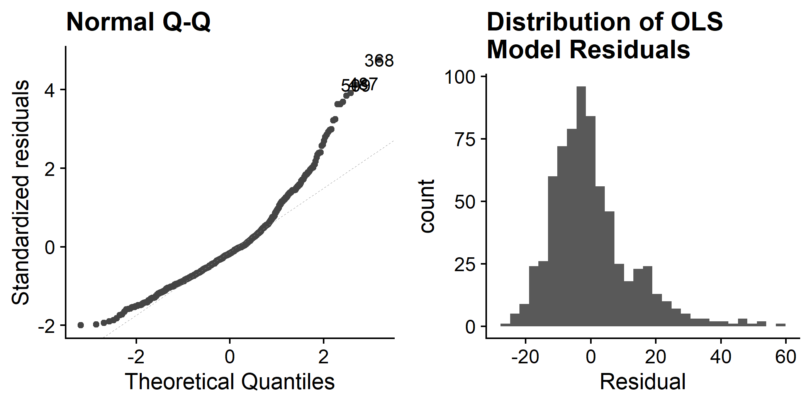
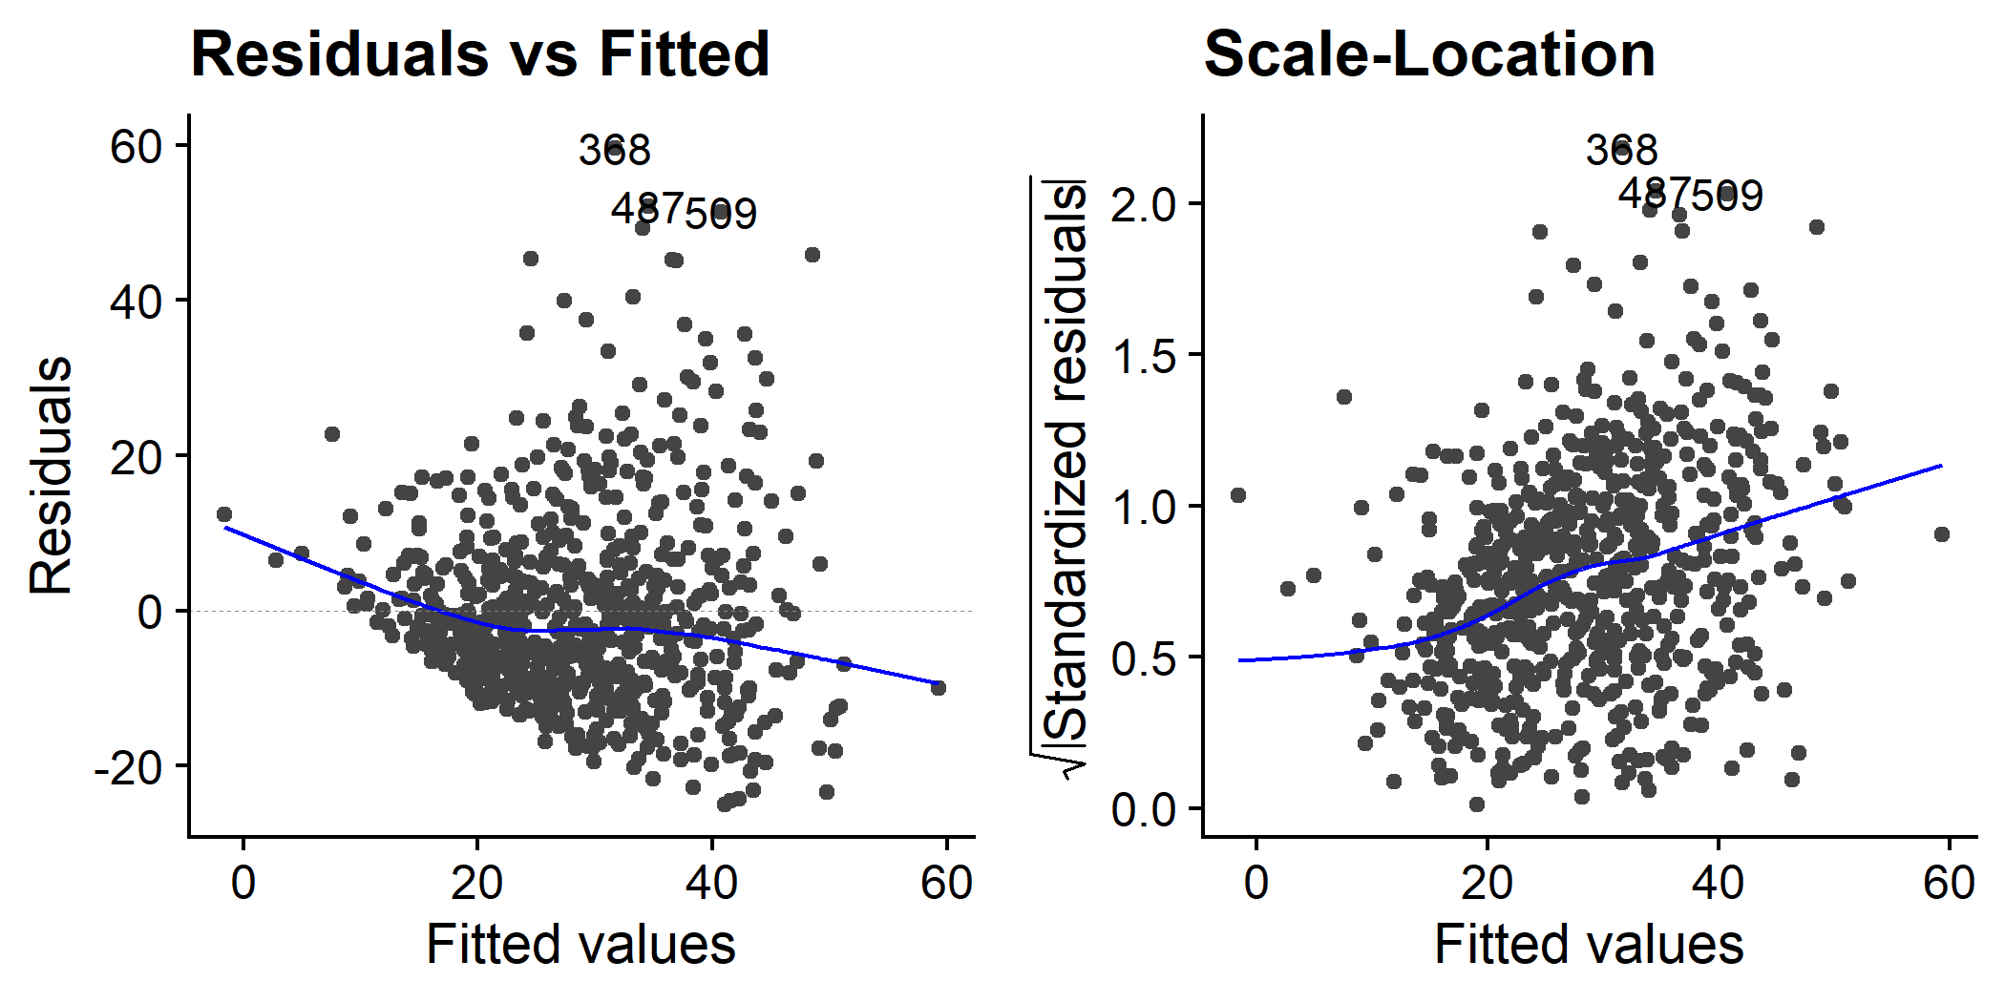

Testing the core assumptions of a linear model
1. Linear relationship to outcome variable
2. Normal distribution of residuals
Shapiro-Wilk test (p<2.2e-16)
3. Constant variance of residuals
4. Independence of observations
Breusch-Pagan test (p=2.672e-05)
Notes:
Now we’re ready to examine the four core assumptions of a linear regression model,
[click] The first being a linear relationship to the outcome variable. Each of the quantitative predictor variables shown here does indeed display at least a weak linear association to CSF PTAU levels.
[click] The second assumption is that the model residuals are normally distributed, which as you can see was not the case for the out-of-the-box ordinary least squares model.
[click] The third assumption is that the residuals exhibit constant variance across all fitted values of the outcome variable, but there is a funneling effect in the residuals vs fitted plot indicating heteroscedasticity.
[click] The final assumption is that each observation is independent from the others. Since each observation pertains to a unique individual and we’re not dealing with time-series data that exhibits temporal autocorrelation, it is safe to assume that this criterion is met.

Slide 7
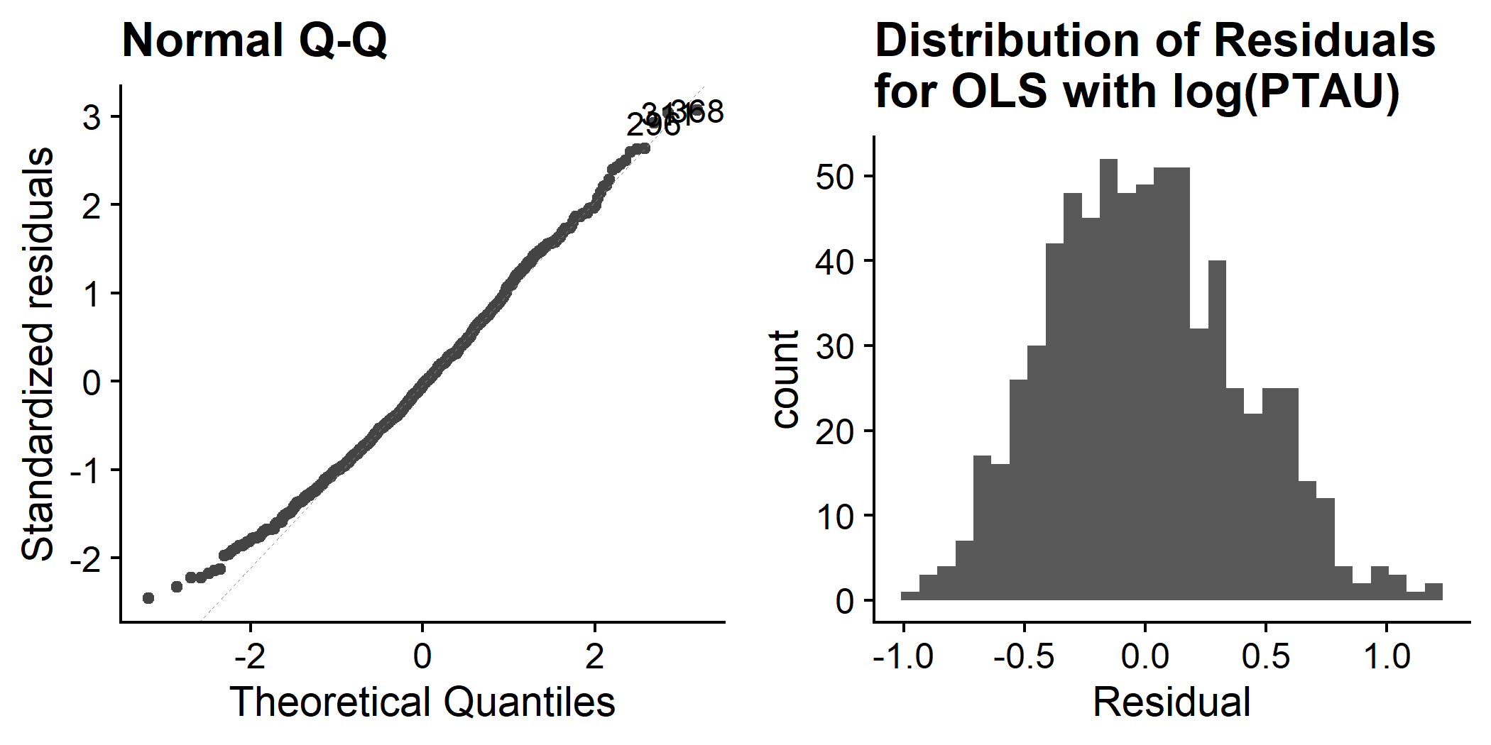
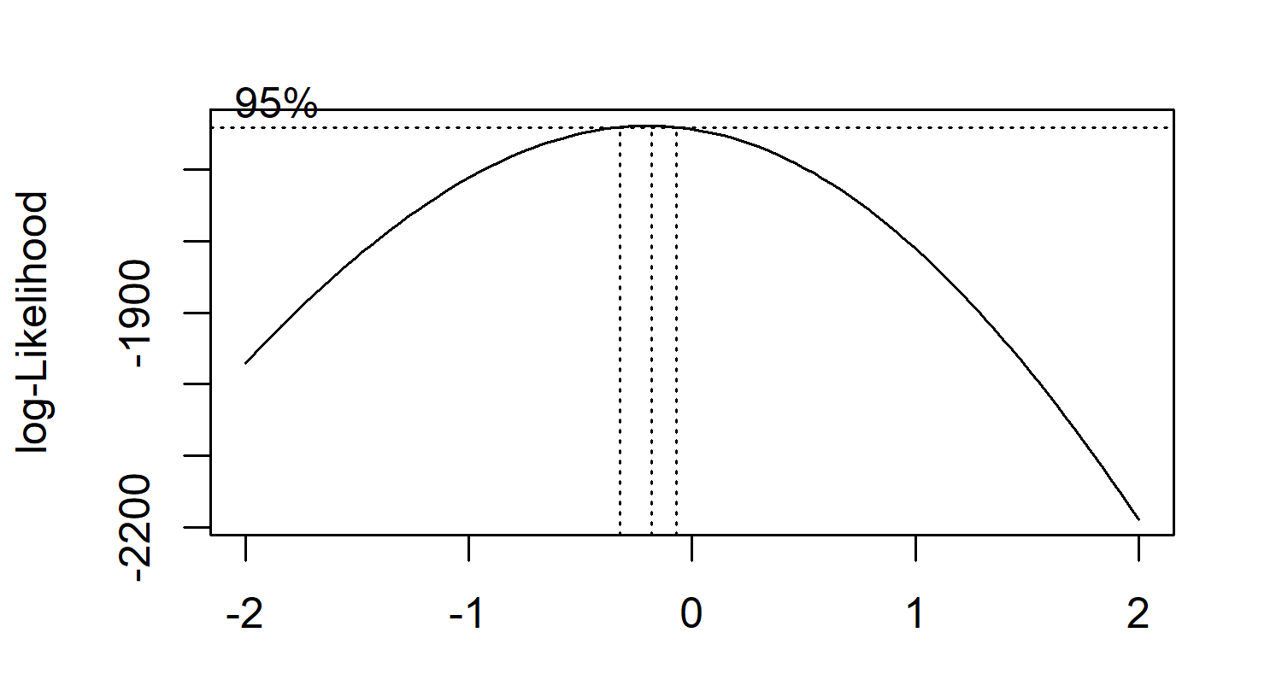
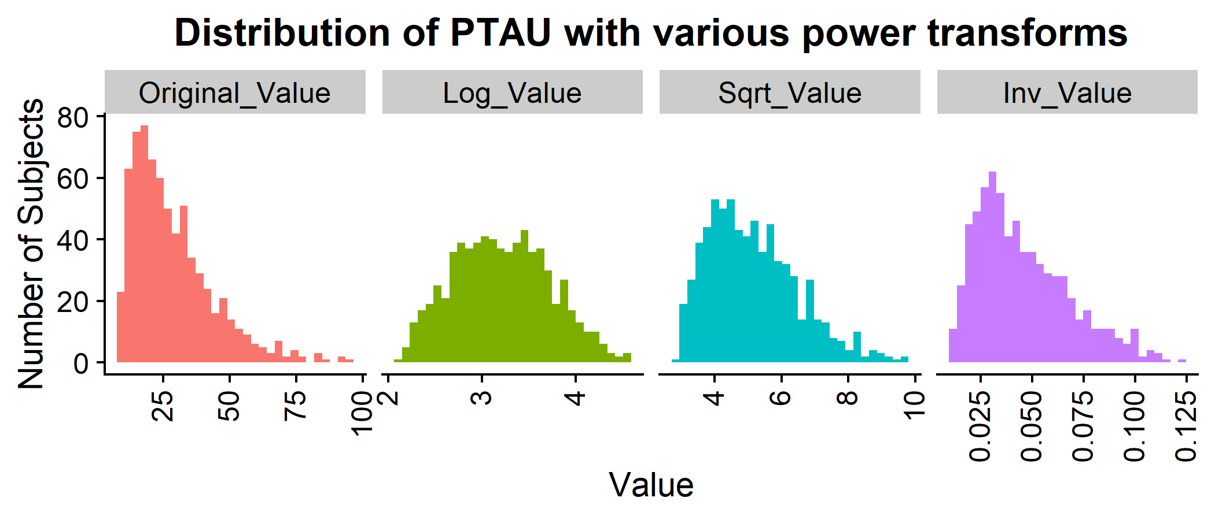
Mitigating assumption violations: non-normal residual distribution
Shapiro-Wilk test: p<2.2e-16
Shapiro-Wilk test: p = 0.001995
Box-Cox Power Transformation
λ = 0
λ = 0.5
λ = -1
Notes:
I sought to mitigate the issue with non-normal distribution of residuals by applying a power transformation to the outcome variable, CSF PTAU.
[click] A typical method of evaluating potential transforms involves using the Box-Cox method, with the goal being identifying a value of lambda on the x-axis that falls within the 95% confidence interval.
[click] I picked a few standard lambda values associated with common transforms, and lambda = 0 (which equates to a log transformation) yielded the distribution closest to normal. This was supported by the lambda value of 0 being very close to falling within the Box-Cox 95% CI.
[click] After log-transforming the outcome variables, while the residual distribution is still statistically different from a normal distribution, it is clearly closer to normally distributed than without the transformation.

Slide 8

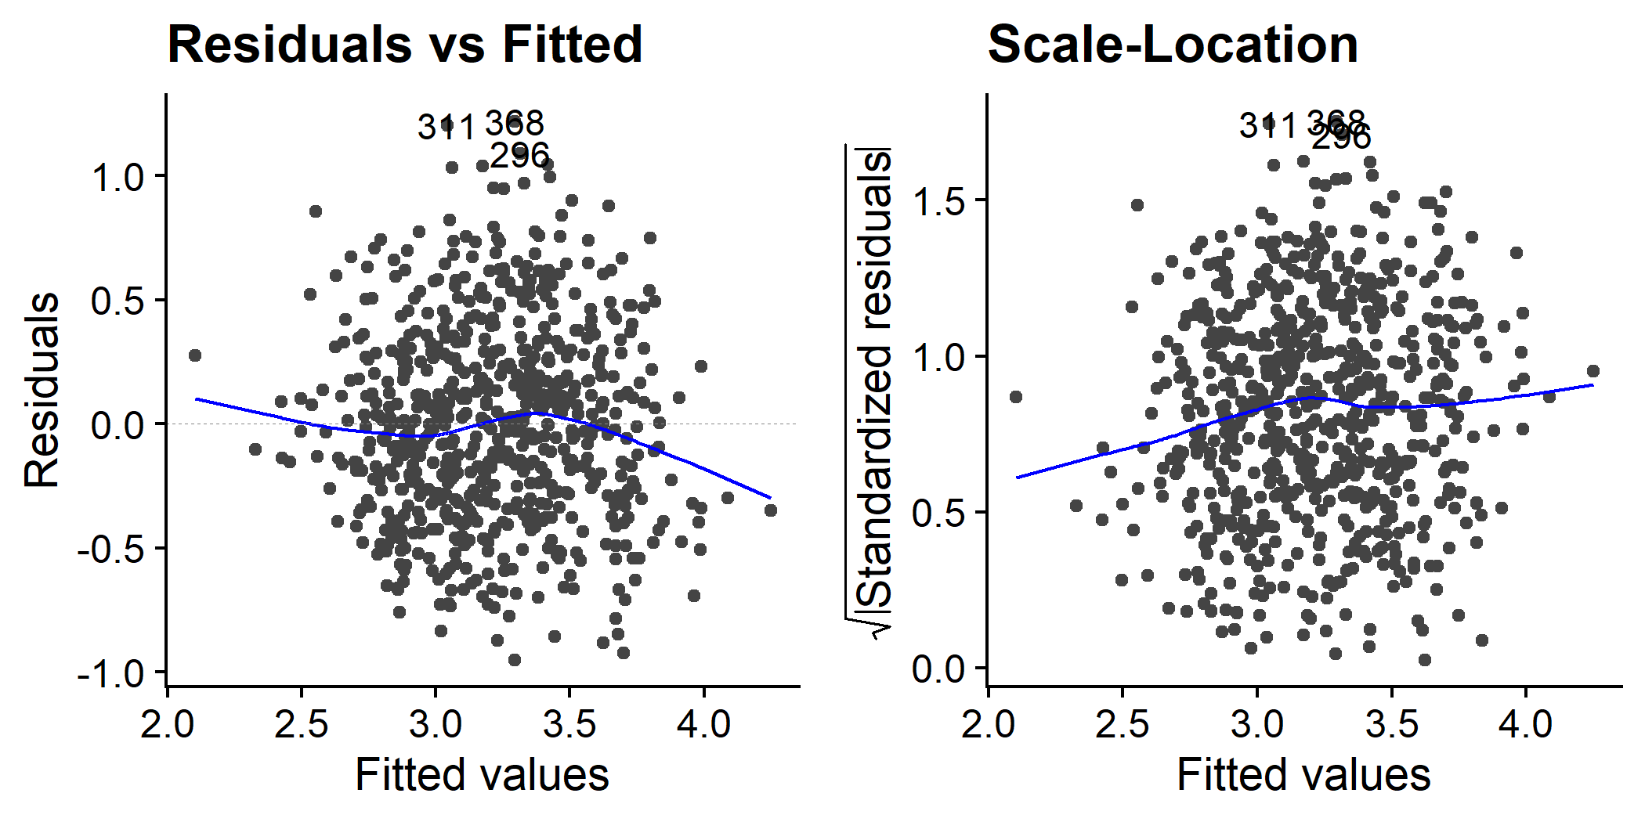
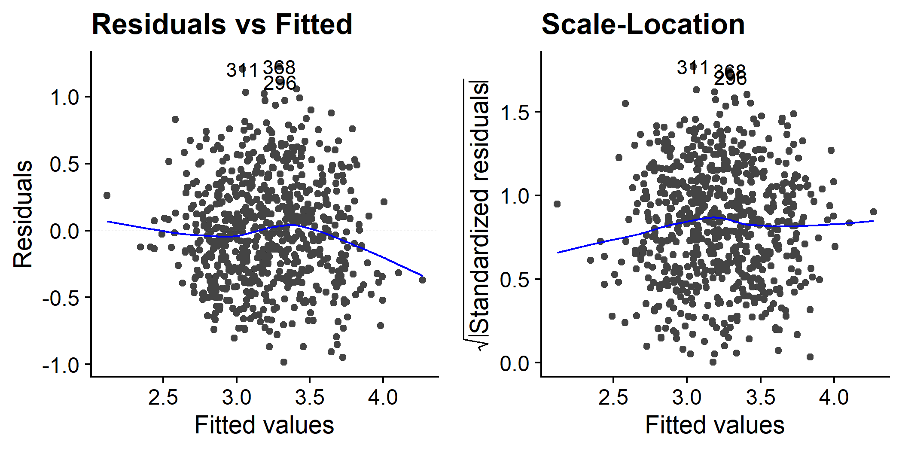
Mitigating assumption violations: heteroscedasticity
Method 1: Weighted least squares (WLS) regression
Method 2: Heteroscedasticity-robust standard errors
Equation source⁴
Breusch-Pagan test: p=3.295e-06
Term | OLS | OLS with Robust Estimator
ADAS13 | 0.339*** (0.078) | 0.339*** (0.083)
APOE4_TRUE | 0.207*** (0.035) | 0.207*** (0.037)
PTGENDER_Female | 0.111* (0.04) | 0.111* (0.039)
AGE | 0.093*** (0.019) | 0.093*** (0.02)
ICV | 0.055 (0.034) | 0.055 (0.031)
Entorhinal | 0.031 (0.023) | 0.031 (0.023)
WholeBrain | 0.021 (0.039) | 0.021 (0.039)
Fusiform | 0.012 (0.024) | 0.012 (0.024)
PTHIGHERED_TRUE | 0.01 (0.033) | 0.01 (0.032)
CDRSB | 0.005 (0.026) | 0.005 (0.03)
`PTMARRY_Never married` | -0.003 (0.086) | -0.003 (0.09)
Hippocampus | -0.034 (0.026) | -0.034 (0.027)
FDG | -0.037 (0.022) | -0.037 (0.022)
PTMARRY_Widowed | -0.038 (0.055) | -0.038 (0.059)
MidTemp | -0.041 (0.027) | -0.041 (0.027)
ABETA | -0.066** (0.019) | -0.066** (0.018)
PTMARRY_Divorced | -0.067 (0.06) | -0.067 (0.059)
MMSE | -0.072* (0.026) | -0.072 (0.028)
PTRACCAT_Asian | -0.132 (0.144) | -0.132 (0.226)
PTRACCAT_Black | -0.147 (0.092) | -0.147 (0.102)
Ventricles | -0.187*** (0.022) | -0.187*** (0.021)
ADAS11 | -0.241** (0.072) | -0.241* (0.075)
`PTRACCAT_More than one` | -0.27* (0.137) | -0.27* (0.105)
`PTRACCAT_Am Indian/Alaskan` | -0.322 (0.29) | -0.322 (0.215)
`PTRACCAT_Hawaiian/Other PI` | -0.375 (0.29) | -0.375* (0.158)
Breusch-Pagan test: p=3.295e-06
Original OLS
Log(PTAU)
Breusch-Pagan test: p=0.01294
Log(PTAU)+ WLS
Breusch-Pagan test: p<2.2e-16
Notes:
The second issue to address is that of heteroscedasticity.
[click] First I checked if log-transforming the outcome variable from the previous slide resolved this issue, and while the variance visually appears to be more constant across fitted values, the Breusch-Pagan test indicates that there is still heteroscedasticity present.
[click] One common method to get around this issue is to apply weighting to the least squares model. One downside to this method is that the proper weights to apply are generally unknown, but we can estimate weights for each observation based on the inverse proportion of variance at each observation’s outcome variable level. However, applying weighted least squares did not improve the heteroscedasticity issue, so I didn’t move forward with this.
[click] The second method I tried involves using heteroscedasticity-robust standard errors using the “sandwich” estimator,
[click] named as such because the equation for the point estimate of variance resembles a sandwich.
[click] This doesn’t affect the coefficient estimates themselves but yields standard error estimates that are valid even in the face of heteroscedasticity.

Slide 9
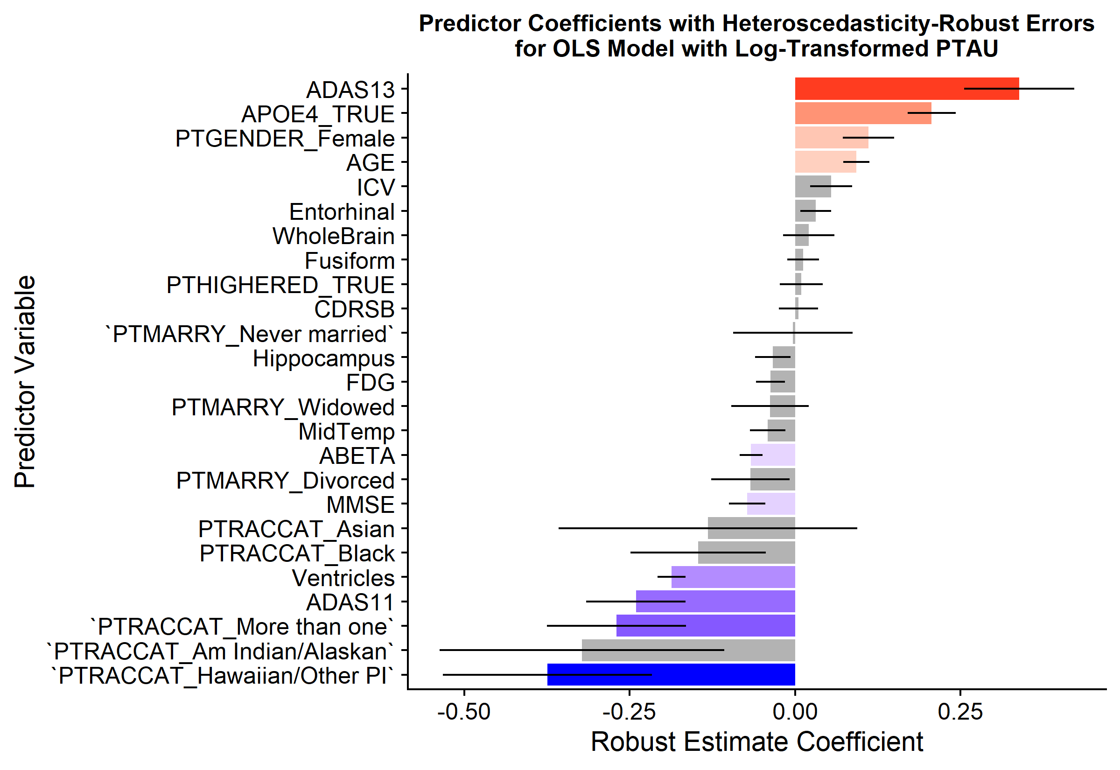
Modeling PTAU levels in the CSF using a subset of predictors
ADAS13, APOE4 allele, Female, Age
Hawaiian/Pacific Islander, More than one race, ADAS11, Ventricle volume, MMSE score, CSF ABETA level
Not significant
R² = 0.4001,
Adjusted R² = 0.3779
Notes:
So the final results I’m showing here are using an ordinary least squares model with a log-transformed outcome variable (CSF PTAU) and heteroscedasticity-robust standard errors. The bars indicate the estimated coefficients for each predictor term and are colored in for the significant predictor terms only.
[click] Here I’ve highlighted the most significant positive predictors,
[click] And here I’ve highlighted the most significant negative predictors.
[click] Here I’ve shown the R² and adjusted R² for the final model.

Slide 10
Conclusions and limitations
Key takeaways
Limitations
Follow-up research
ADAS13 cognitive score and the presence of at least APOE4 allele are most strongly associated with higher CSF PTAU, while multiple racial backgrounds, ADAS11 score, and ventricle volume have the strongest negative associations with CSF PTAU.
Class imbalances mean that some binarized factor variables represent only a small fraction of the whole population (e.g. PTRACCAT_Hawaiian/Other PI = 9 participants).
An adjusted R² of ~37% means the majority of variance is not explained by the current predictor terms.
Do the strong associations between racial backgrounds persist with more diverse study populations?
Why might ventricular volume be inversely related to CSF PTAU levels when both are positively associated with disease progression?
Notes:
Some of the key takeaways form this analysis are that ADAS 13 cognitive score and the presence of at least one mutation in the Apolipoprotein E gene are associated with higher CSF PTAU, while multiple racial backgrounds, ADAS11 score, and ventricular volume are associated with lower CSF PTAU.
[click] There are several limitations to this dataset and this analysis, including that the vast majority of participants are Caucasian so there are class imbalances and the adjusted R² of 37% means that most of the variance in CSF PTAU was not explained by this model. It’s also of note that there was potential multicollinearity and heteroscedasticity still present in this model.
[click] Some follow-up questions based on this analysis would be to explore whether the observed associations between racial backgrounds and CSF PTAU hold up in more racially balanced study populations and why ventricular volume and CSF PTAU might be inversely related in this model when they are both positively associated with progression of AD.

Slide 11
References
Jin, J. (2015). Alzheimer disease. JAMA, 313(14), 1488-1488.
Mueller, S. G., Weiner, M. W., Thal, L. J., Petersen, R. C., Jack, C. R., Jagust, W., ... & Beckett, L. (2005). Ways toward an early diagnosis in Alzheimer’s disease: the Alzheimer’s Disease Neuroimaging Initiative (ADNI). Alzheimer's & Dementia, 1(1), 55-66.
ADNI Team (2022). ADNIMERGE: Alzheimer’s Disease Neuroimaging Initiative. R package version 0.0.1. https://adni.bitbucket.io/index.html
Ford, C. (2020). Understanding robust standard errors. Lecture Notes, The University of Virginia. https://data.library.virginia.edu/understanding-robust-standard-errors/
Thank you for your attention ☺
Notes:
And with that, I would like to cite my sources and thank you for your attention, and I welcome any questions or feedback!

